Slide 1
Artificial Intelligence
Course Code: CS-202
Introduction to Artificial Intelligence and its History
Instructor: Habiba Arshad

Slide 2
Course administration
Instructor: Habiba Arshad (Lecturer, Deptt of Computer Science, University of Wah, Wah Cantt).
Contact Information: habiba.arshad@uow.edu.pk

Slide 3

For queries related to course(Assignments/Projects) just leave an email at habiba.arshad@uow.edu.pk
during office timings 08:00AM - 04:00 PM

Slide 4
Evaluation Criteria (2+1 Credit hrs)
Assessment | %Age
Assignments/ Quizzes | 10% + 15% = 25%
Mid Term Exam | 30%
Final Term Exam | 45%
Total | 100

Slide 5
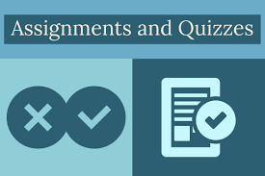
Quizzes
Assignments
Assignments will be due at the beginning of the class. Under normal circumstances, late work will not be accepted.
Students are expected to do their own assignments.
Plagiarism will be observed strictly.
Oral quizzes to check the understanding of previous lecture before starting the next.
Announced quizzes to assess the understanding of taught topics.

Slide 6

Few Things to Remember
Show sensibility in your conduct.
Learning should be your primary objective.
Attendance will be marked within 10 minutes at the start of the class.
80% of your attendance is mandatory.
Zero tolerance policy on attendance, discipline in class during lectures.
Assignments must be submitted on time, no late submissions.
In case of copied assignment both parties will be given zero.
Don’t miss your Classes, Quizzes, Presentations, Assignments and Projects/Presentations.
You all need to be a good human being.

Slide 7

Google Classroom

Slide 8
Course Objective
The key objectives of this course include:
To comprehend the fundamentals of Artificial Intelligence
To evaluate and implement an appropriate informed or uninformed search algorithm for a problem and characterize its time and space complexity
To translate natural language sentences (e.g., English) into logical statements
To convert logic statements into a clause form and apply resolution to a set of logic statements to answer a query

Slide 9
Objective: Course Learning Outcomes (CLOs)
Discuss
CLO1: Discuss the key concepts in the field of artificial intelligence
Implement
CLO2: Implement artificial intelligence techniques and case Studies
Model
CLO3: Model an automated solution for given problems using artificial intelligence paradigm

Slide 10
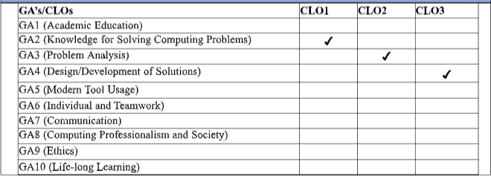
Graduate Attributes

Slide 11

Course Information
Text Books
Artificial Intelligence A Modern Approach by Stuart Russell and Peter Norvig, 4th edition, 2020
Reference Book
Paradigms of Artificial Intelligence Programming: Case studies in Common Lisp”, by Norvig, P.,original edition, 1992.
AI algorithms, data structures, and idioms in Prolog, Lisp, and Java by Luger, G.F. and Stubblefield, W.A., 6 th Edition, 2009.

Slide 12
Course Overview
An Introduction to Artificial Intelligence and its Applications towards Knowledge-Based Systems
Intelligent Agents and Problem solving Agents
Basic algorithms for Problem Solving by Searching
Game-playing and Adversarial Search Case Studies
Expert Systems
Logic and Reasoning
Knowledge Representation
Learning from examples;
Natural Language Processing
Fuzzy logics and Machine Learning

Slide 13

CLO Covered in this Lecture:
CLO1: Discuss the key concepts in the field of artificial intelligence

Slide 14
Why Study AI?
Studying Artificial Intelligence (AI) is important because it helps us design machines and systems that can think, learn, and make decisions like humans.
AI is used in many areas such as healthcare, education, business, robotics, and everyday applications like voice assistants and recommendation systems.
It improves efficiency, automates tasks, and solves complex real-world problems.
Learning AI also opens doors to exciting career opportunities and helps us understand both technology and human intelligence better, while encouraging us to use it responsibly for the benefit of society.

Slide 15
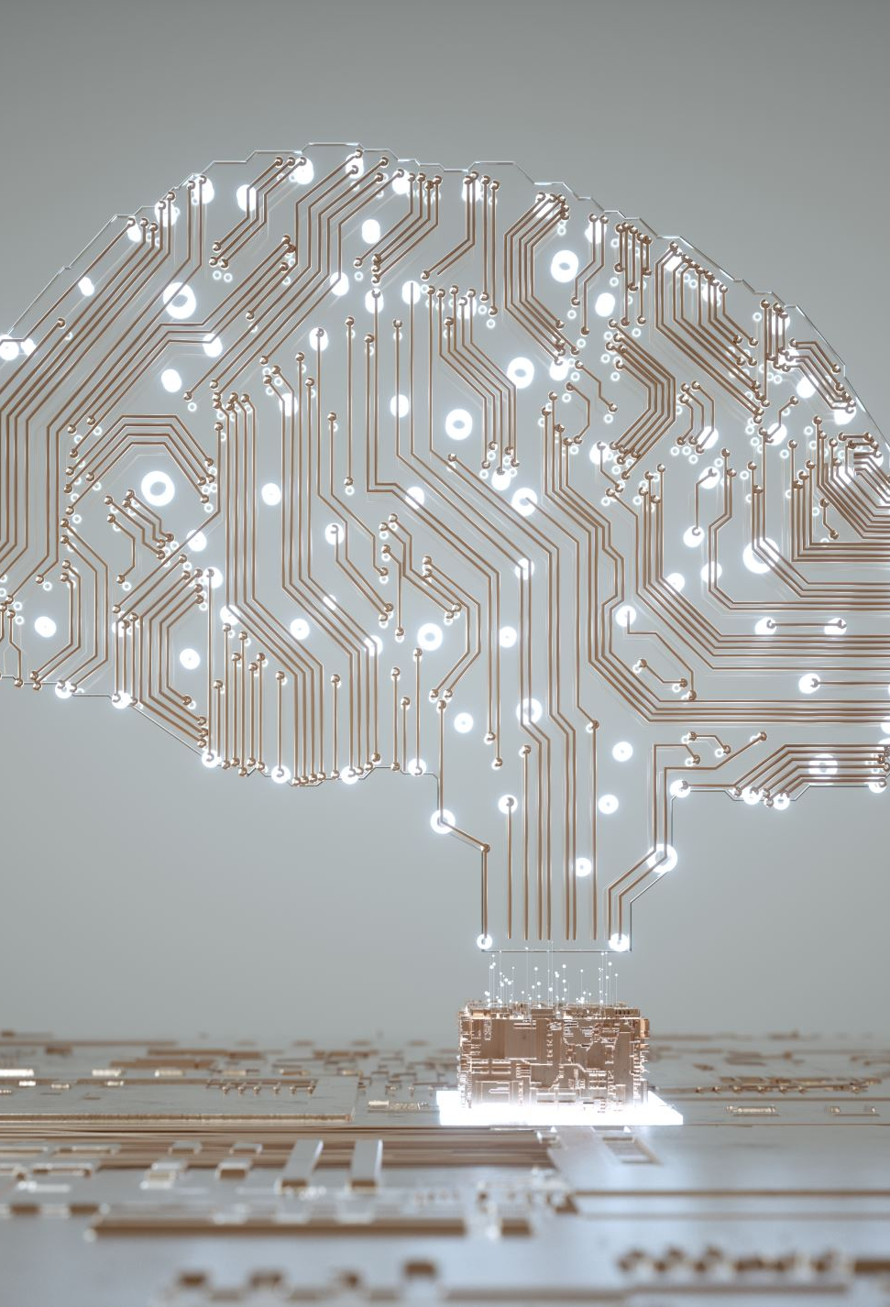
What is Artificial Intelligence?

Slide 16
Artificial Intelligence
Artificial Intelligence (AI) is a branch of computer science focused on creating systems capable of performing tasks that normally require human intelligence.
These tasks include:
Understanding natural language
Recognizing patterns
Making decisions
Learning from experience
AI combines ideas, methods, and knowledge from multiple academic disciplines to solve complex problems and create intelligent behavior in machines.

Slide 17
History and Evolution of Artificial Intelligence
The concept of Artificial Intelligence actually goes back to ancient times.

Slide 18

History and Evolution of Artificial Intelligence
Greek mythology-Talos
Talos was a giant animated bronze warrior programmed to guard the island of Crete, created by Hephaestus.
Talos was considered an automaton — an early vision of what we now call a robot — programmed to follow commands and defend the island.
Notes:
people imagined machines and mechanical beings that could think and act like humans.
fast forward to the 19th and 20th centuries, when Artificial Intelligence began to take shape as a scientific discipline.

Slide 19
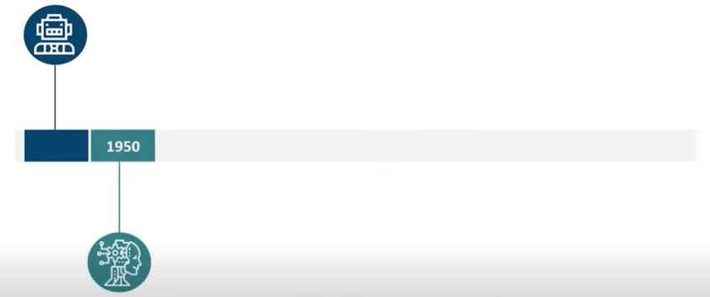
History and Evolution of Artificial Intelligence
1950-Alan Turing
Alan Turing proposed the Turing Test, a method to determine whether a machine can think and respond like a human. The Turing Test was the first serious framework in the philosophy of Artificial Intelligence and remains a foundational concept in AI research.

Slide 20
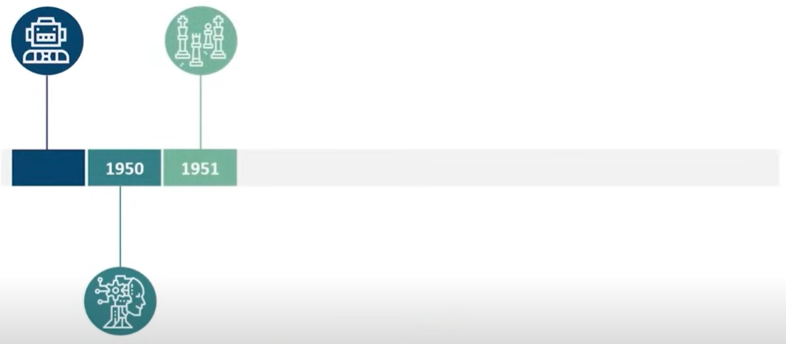
History and Evolution of Artificial Intelligence
1951 – This era marked the beginning of Game AI, when computer scientists developed programs for checkers and chess.
Christopher Strachey wrote a checkers program, and Dietrich Prinz wrote for chess program. These early programs laid the groundwork for modern AI in games and decision-making systems.

Slide 21
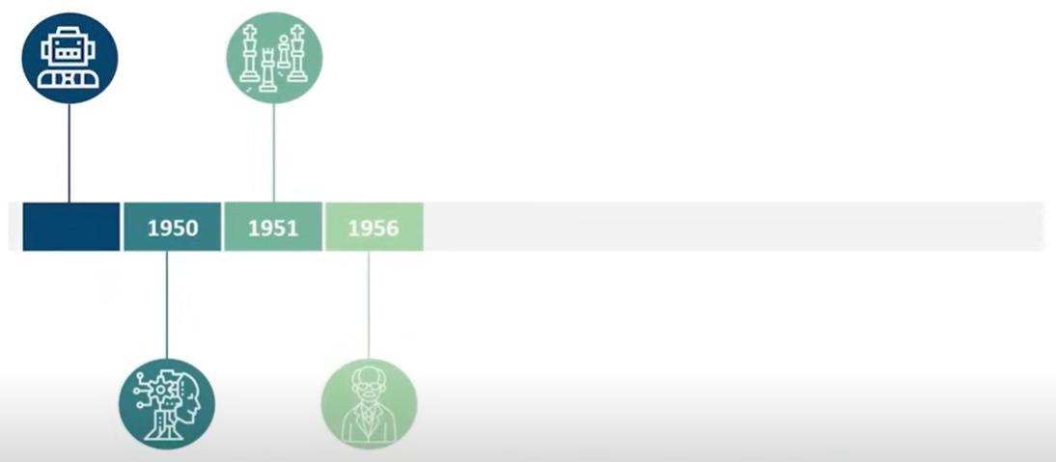
History and Evolution of Artificial Intelligence
1956 – A historic year for AI! John McCarthy coined the term “Artificial Intelligence” during the Dartmouth Conference, which is considered the birth of AI as a field of study.

Slide 22
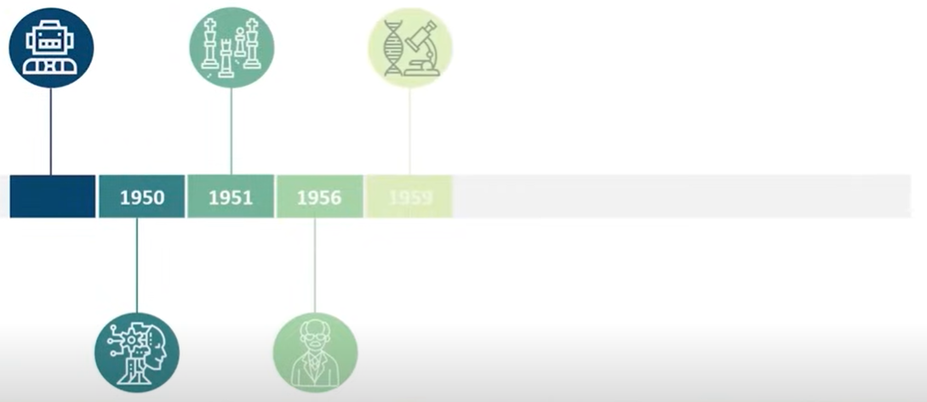
History and Evolution of Artificial Intelligence
1959 – The first AI Laboratory was established at MIT. The MIT AI Lab became a major center for AI research and innovation.

Slide 23
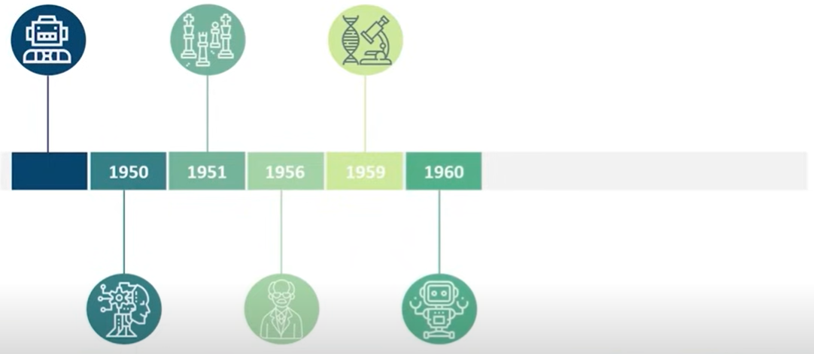
History and Evolution of Artificial Intelligence
1960 – The first industrial robot was introduced to the General Motors assembly line, marking the start of automation in manufacturing.

Slide 24
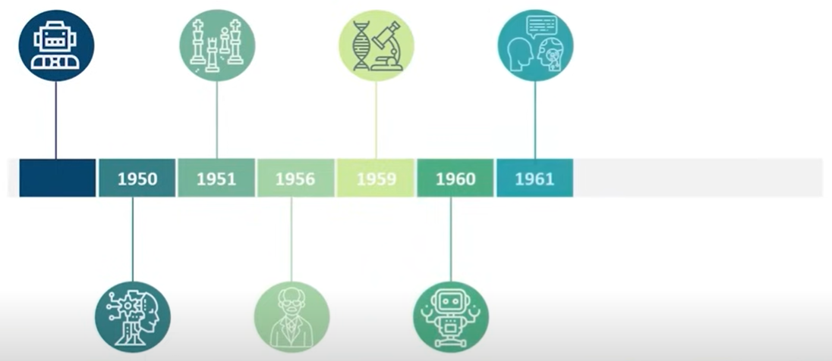
History and Evolution of Artificial Intelligence
1961 – The first AI chatbot, named ELIZA, was created by Joseph Weizenbaum. ELIZA could simulate a conversation with a human — an early example of natural language processing.

Slide 25
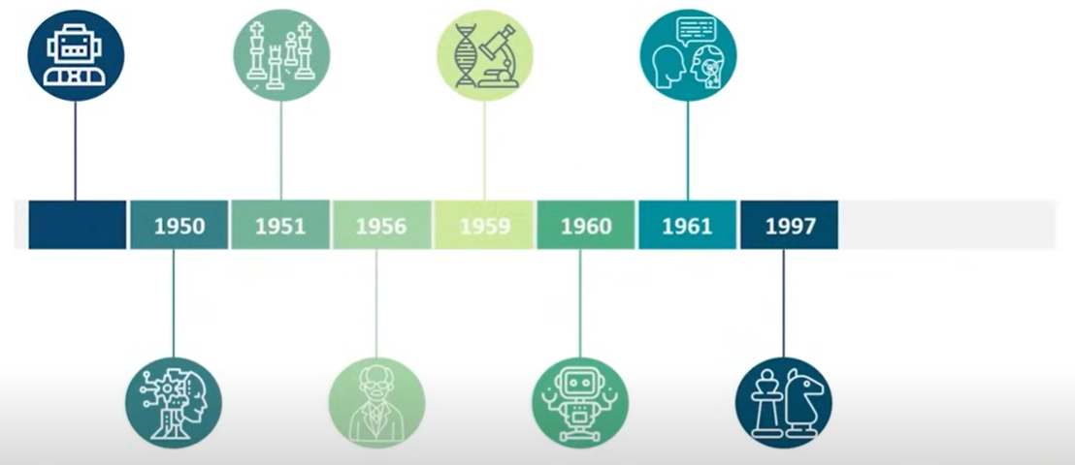
History and Evolution of Artificial Intelligence
1997 – IBM’s Deep Blue made history by defeating world chess champion Garry Kasparov, showcasing AI’s ability to outperform humans in complex strategy games.

Slide 26
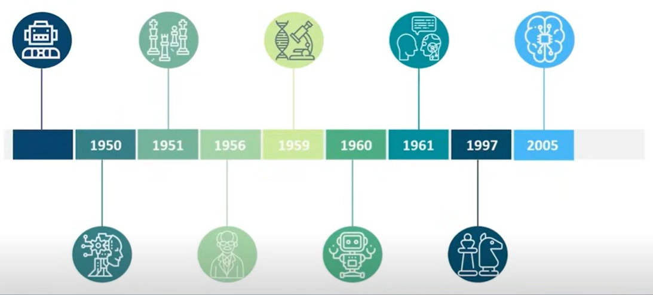
History and Evolution of Artificial Intelligence
2005 – An autonomous robotic car named Stanley won the DARPA Grand Challenge, proving that AI could navigate real-world environments independently.

Slide 27
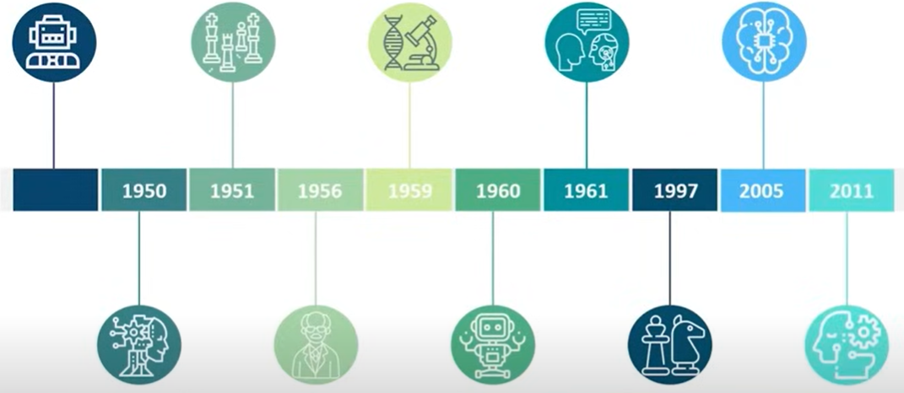
History and Evolution of Artificial Intelligence
2011 – IBM’s Watson, a question-answering AI system, defeated Jeopardy champions Brad Rutter and Ken Jennings, demonstrating AI’s ability to understand and process human language at a deep level.
Notes:
since the emergence of artificial intelligence in 1950s, we have seen an exponential growth in its potential.

Slide 28
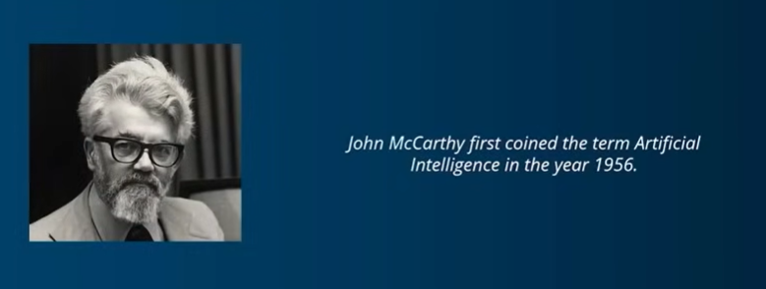
What is Artificial Intelligence?
AI as the science and engineering of making intelligent machines

Slide 29
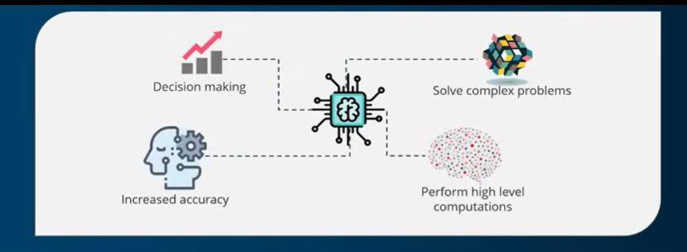
AI can also be defined as:
“The development of computer systems that are capable of performing tasks that require human intelligence such as decision making, object detection, solving complex problems, and so on.”
Notes:
artificial intelligence helps in decision making, solving complex problems, it performs high-level computations, and also increases the accuracy of your predictions.

